Slide 1
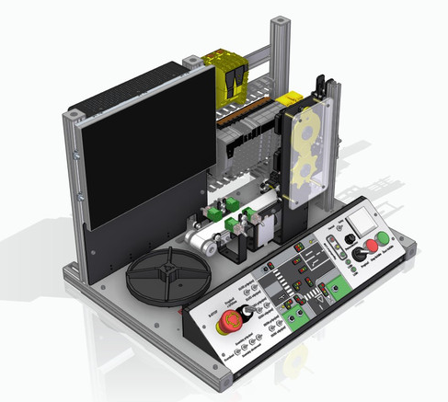
PLC learning module
PJ VERTEX CO.,LTD

Slide 2
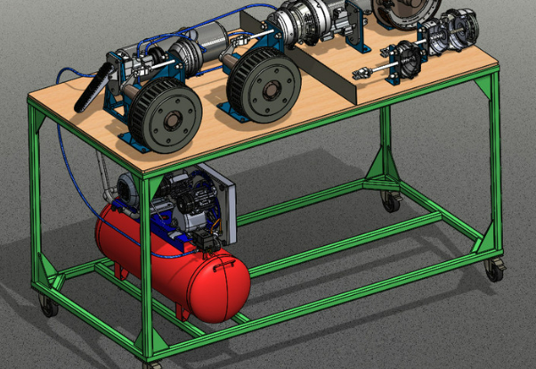
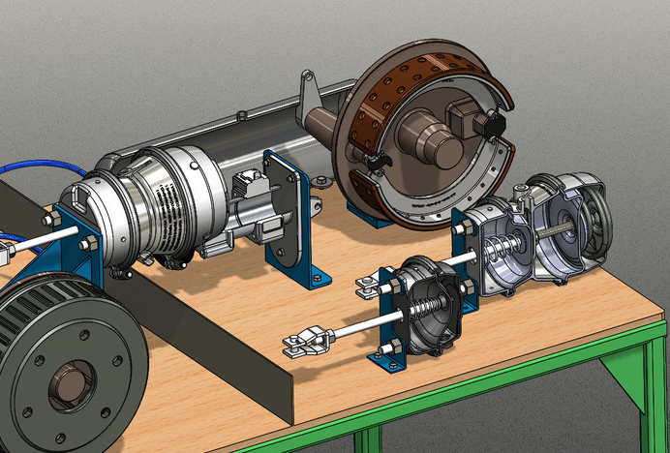
Pneumatic drum brake
PJ VERTEX CO.,LTD

Slide 3
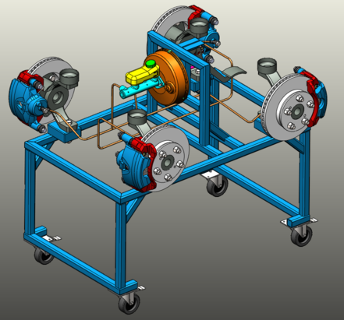
Simulates a disc brake system
PJ VERTEX CO.,LTD

Slide 4
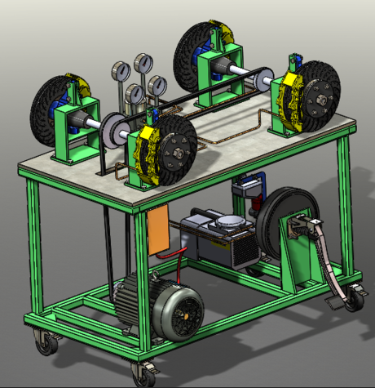
ABS brake model
PJ VERTEX CO.,LTD

Slide 5
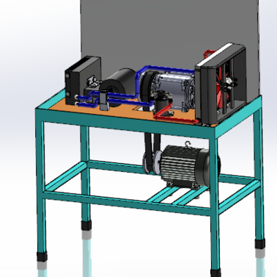
TOYOTA cooling system
PJ VERTEX CO.,LTD

Slide 6
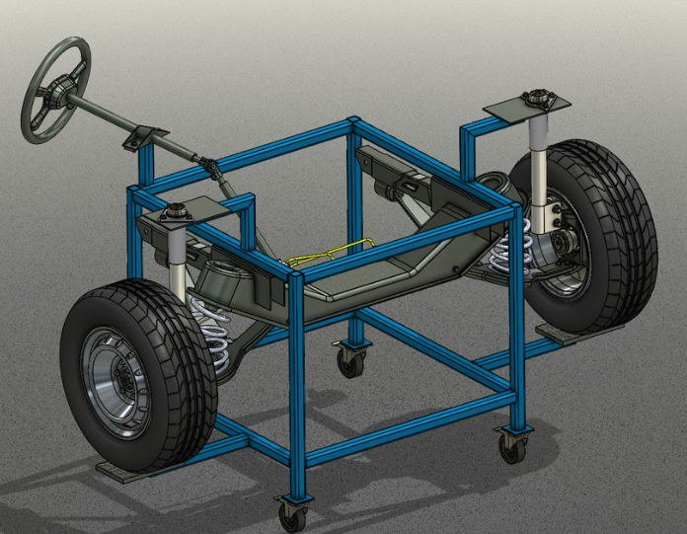
Steering suspension system
PJ VERTEX CO.,LTD

